Slide 1

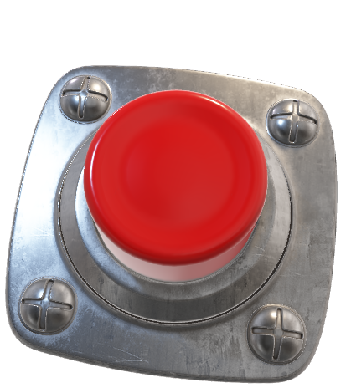
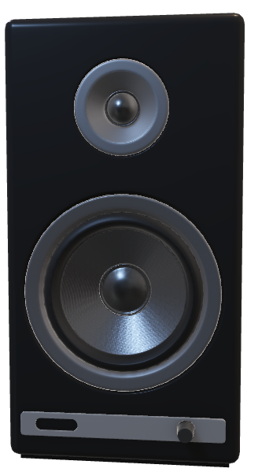
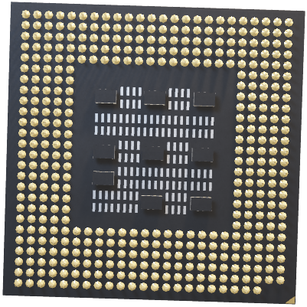
ARM COURSE PROJECT
TEAM 13
TEAM MEMBERS
SHIVANANDA 528
RACHANNA 529
SONAL 530
ADITYA 557

Slide 2

Problem Statement
Water supply board want to implement remote monitoring and controlling of water level tank as motor should be on only when there is a water supply. To serve the need, develop a system to monitor water level and display the level on LCD. If water level is below the threshold remote on a motor by pressing on button once the water reaches above threshold off motor . Assume LCD and KEYPAD with user side and motor and level measuring sensor is at remote place

Slide 3
INTRODUCTION
It is assumed that water would be the prominent reason for world war 3. So it is the prime responsiblity of government to take acute measures in order to conserve water. One of the major reason for water wastage is due to overflow of tanks. In the era of modern technology everything is revoluntionised with modern tech and equipments.So we came up with the idea of reducing human interference and save time to monitor the water level in the tanks. By this we can control the switch on and off of motor from remote place by reading values on display which is interfaced with sensor.

Slide 4
PROBLEM ANALYSIS
ASSUMPTIONS MADE: User have almost access to the dc motor.
PERIPHERALS USED: LCD , KEYPAD , DC MOTOR ,UART,SWITCH

Slide 5
BLOCK DIAGRAM
SYSTEM SIDE
USER SIDE
ULTRASONIC SENSOR
LCD
UART
DC MOTOR
KEY PAD
WATER TANK

Slide 6
ALGORITHM
START
Initialize all the peripherals.
Read timing value from the trigo and echo pins of ultrasonic sensor.
Using timing values calculate the distance and print it on UART terminal.
According to the threshold values and checking the switch condition user input to turn on or off the motor.
If switch is off and motor is on: Display the warning that motor to turn off, if the input is again “on”, Display Instruction override, Turn off the motor automatically.

Slide 7
Check for the condition of switch with threshold value and continue to monitor the height of water and turn on and off the motor.
Repeat this process continuously.

Slide 8
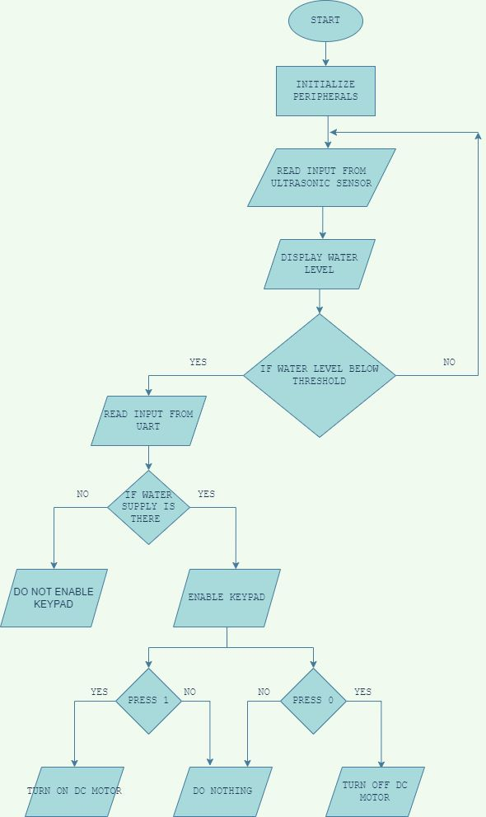
FLOW CHART

Slide 9
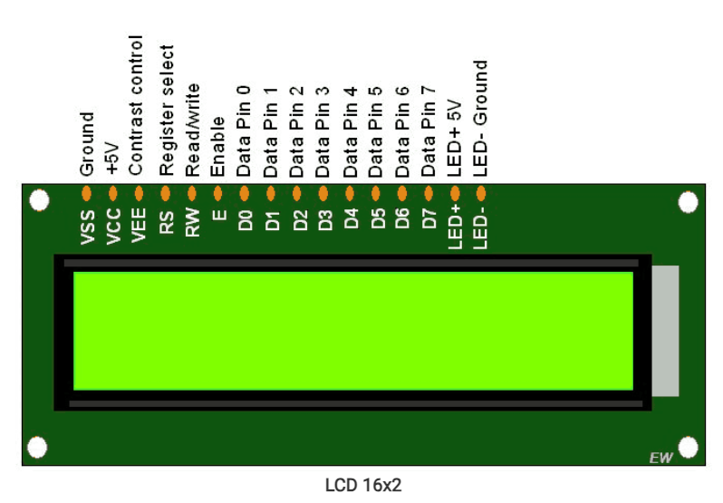
Specifications of Peripherals used : LCD
16*2 -The LPC2148 microcontroller supports alphanumeric LCD modules with a standard character display. It does not support graphical LCDs
The LCD module requires a separate power supply, typically 5V. The LPC2148 microcontroller provides the necessary signals for powering and controlling the LCD.
The LPC2148 sends commands to the LCD module to control various aspects such as cursor movement, display clear, character write, etc. Each command is typically a specific combination of control pin states.
As Lcd works in both 4 and 8Bit mode. Here we used LCD in 4bit mode.

Slide 10
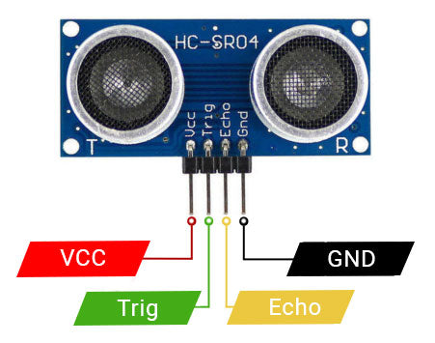
Specifications of Peripherals used : Ultrasonic Sensor
Ultrasonic sensor HCSR04
The Ultrasonic sensor requires a separate power supply, typically 5V. The LPC2148 microcontroller provides the necessary signals for powering and controlling.
Here we used the Ultrasonic sensor of range 4-400cm
It has 4 pins vcc,ground,echo,triger, and works based on ecolocation it produces the burst of 40khz sound wave.

Slide 11
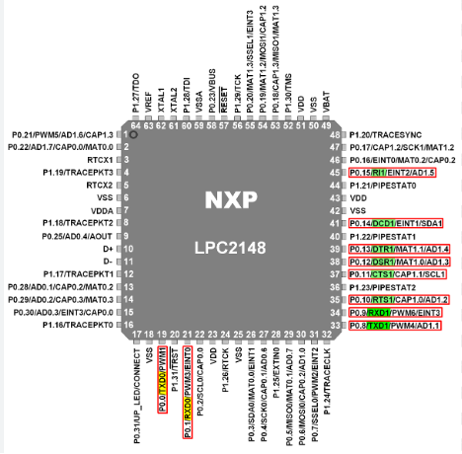
Specification of peripherals used : UART
8 bit receive and transmit FIFOs
Built-in fractional baud rate generator with autobauding capability
Software and hardware flow control through TXEN bit in Transmit enable register.
The UART modules in LPC2148 support the standard asynchronous serial communication protocol, which includes start and stop bits, and configurable baud rates.

Slide 12
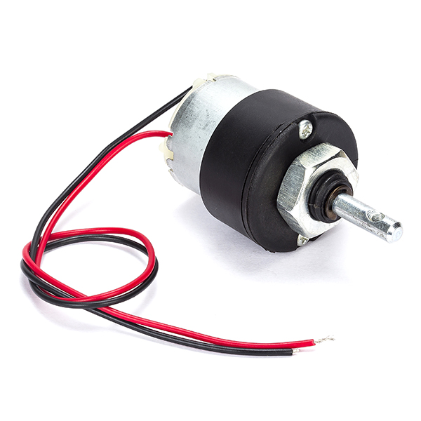
DC MOTOR
1.Here we are using Dc motor
2.It has two inputs
3.We can control rotation by controlling these two inputs.
IN1=0 IN2=0 ➔ MOTOR off
IN1=1 IN2=1 ➔ MOTOR off
IN1=0 IN2=1 ➔ MOTOR on
IN1=1 IN2=0 ➔ MOTOR on

Slide 13
Calculation :
DISTANCE BETWEEN ULTRSONIC SENSOR AND OBJECT= (TIME/2)*SPEED OF SOUND
SPEED OF SOUND=343 m/sec

Slide 14
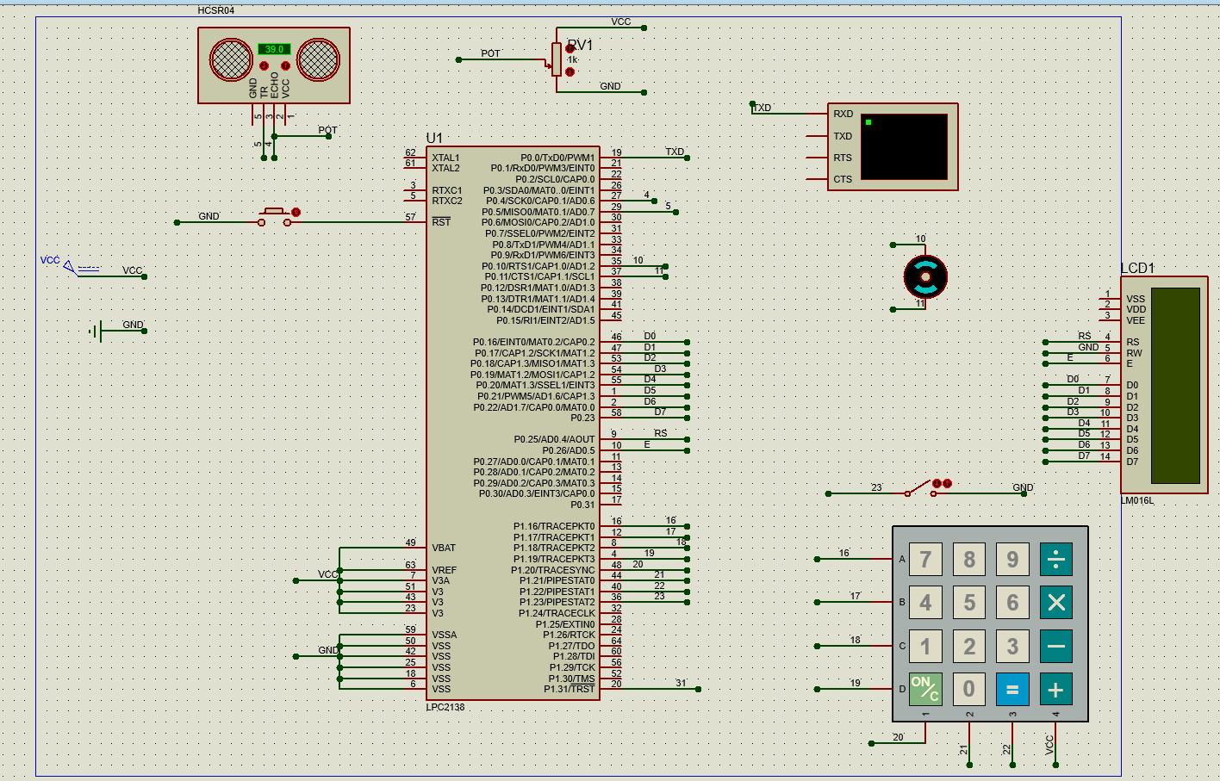
INTERFACING DIAGRAM

Slide 15
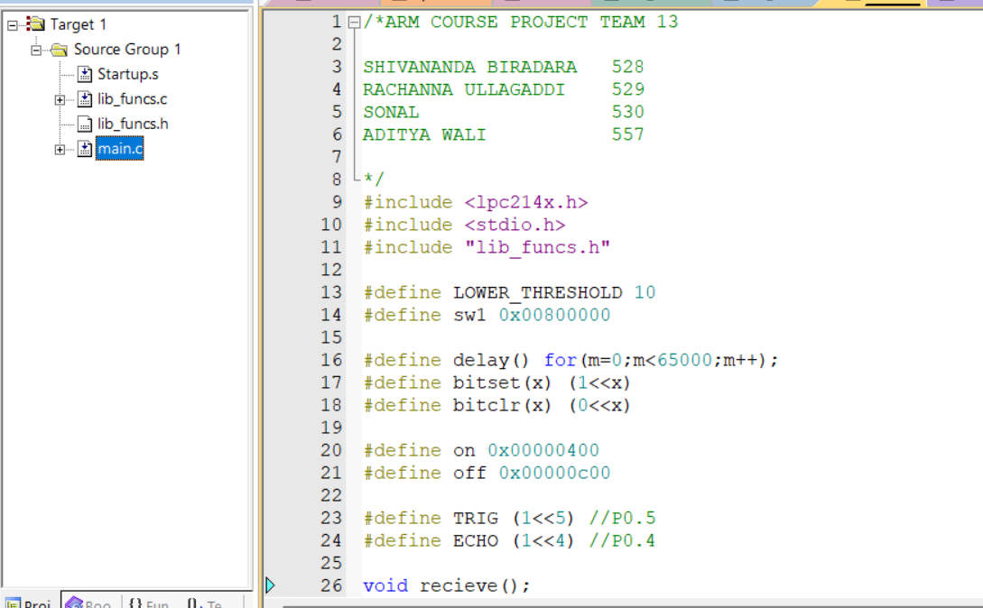
C PROGRAM

Slide 16
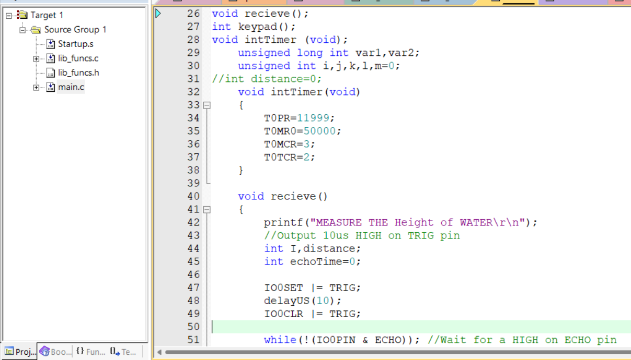

Slide 17
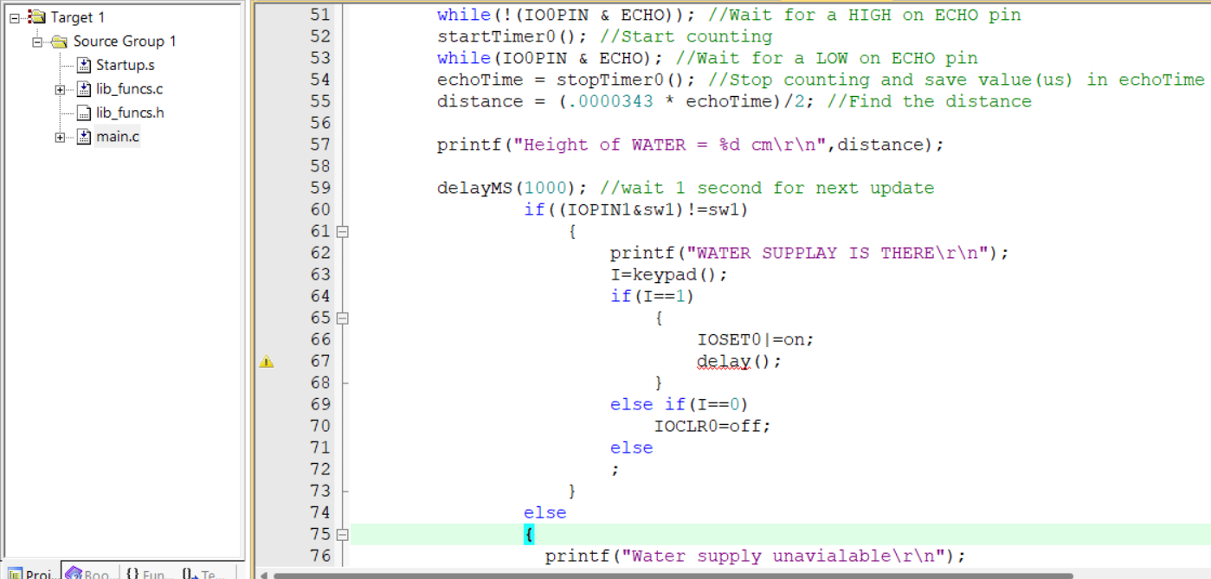

Slide 18
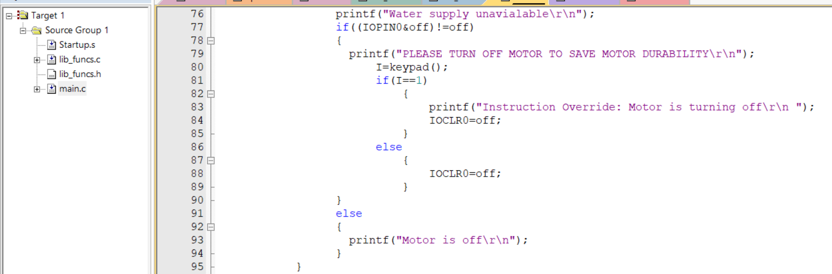

Slide 19
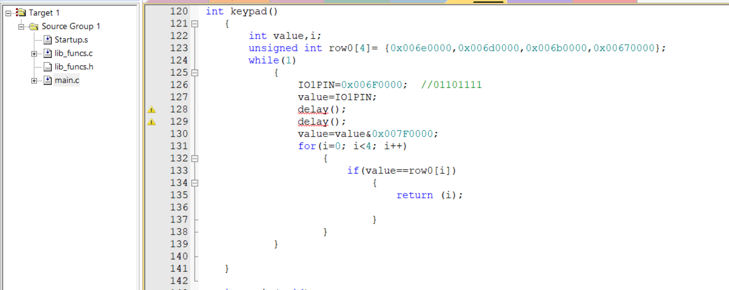

Slide 20
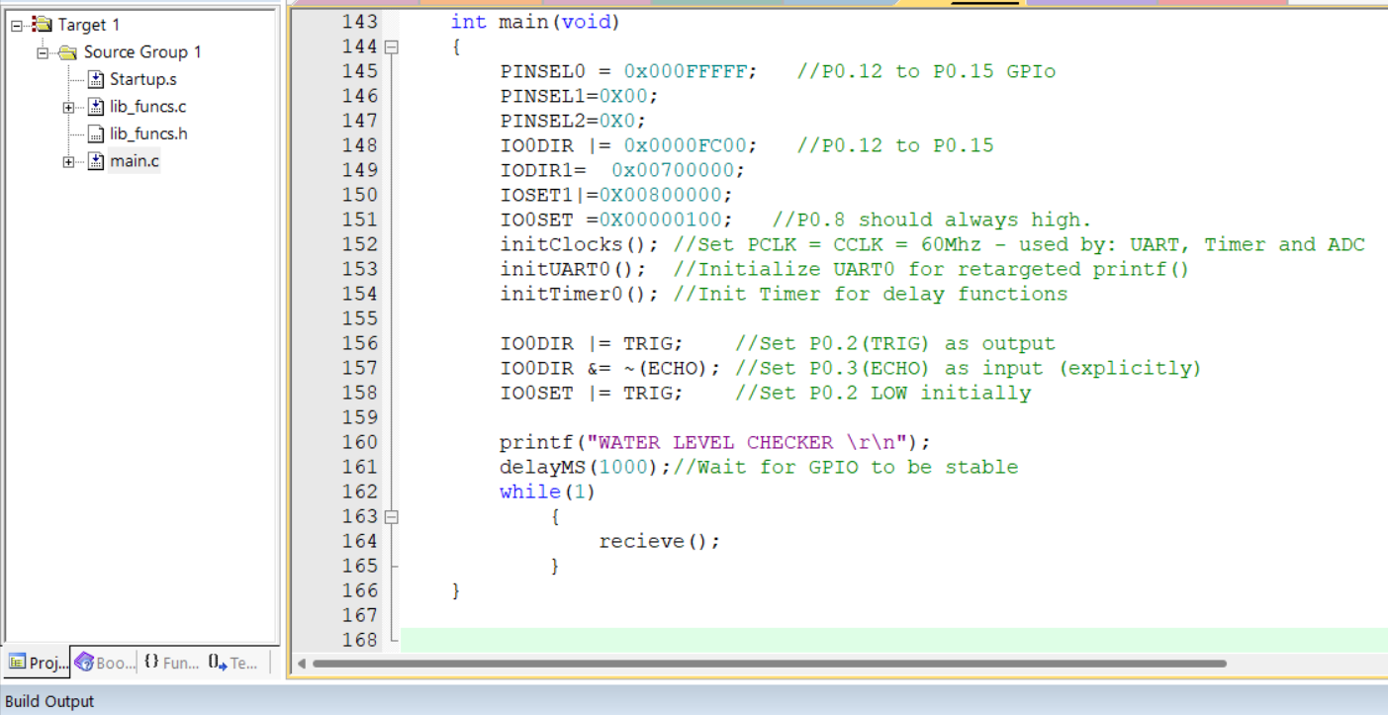

Slide 21
TIME AND MEMORY COMPLEXITY ANALYSIS
MEMORY USED 4552bytes
As no extra memory used for like Matrix(Multidimension array) an other and We Have used Macros and call by reference The memory complexity will be : O(n)
Time complexity calculation
Number of for loops= 2 →n+1
Number of while loops = 4 →n+1
For and while loops combinations=1 →n^2
Now over all Time complexity is
2n+2+4n+4+n^2
=n^2+6n+6
=O(n^2)

Slide 22
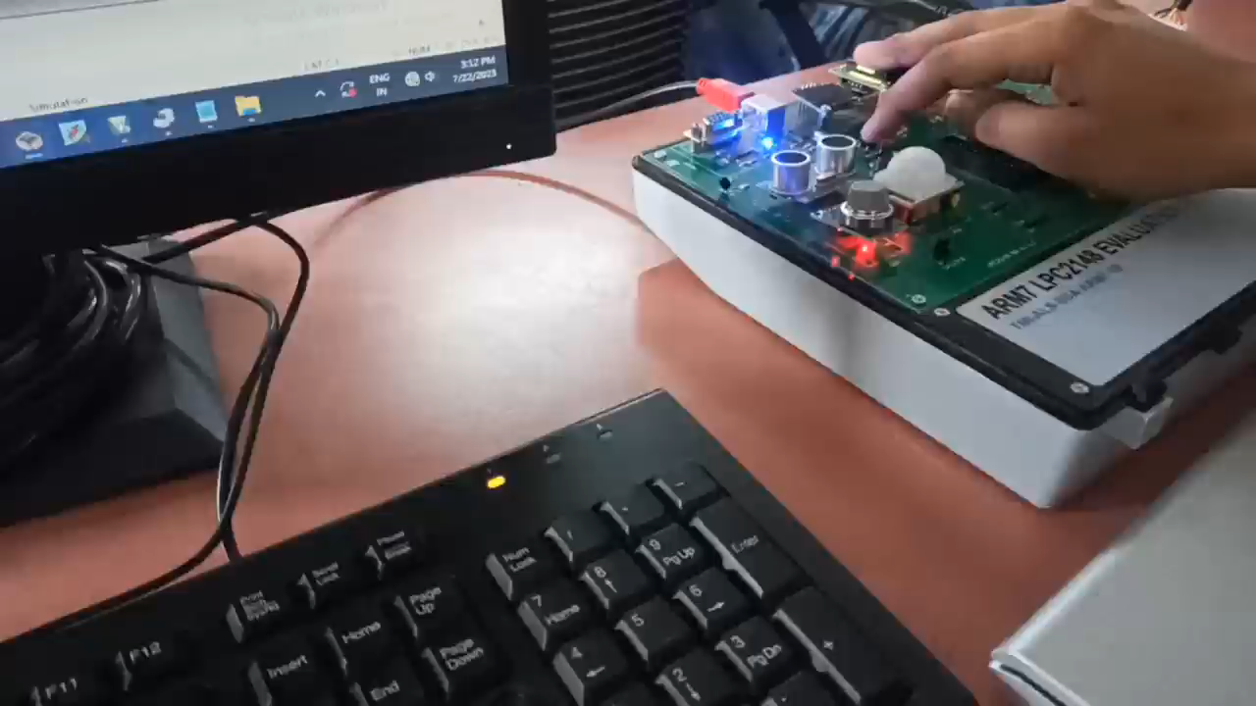

Slide 23
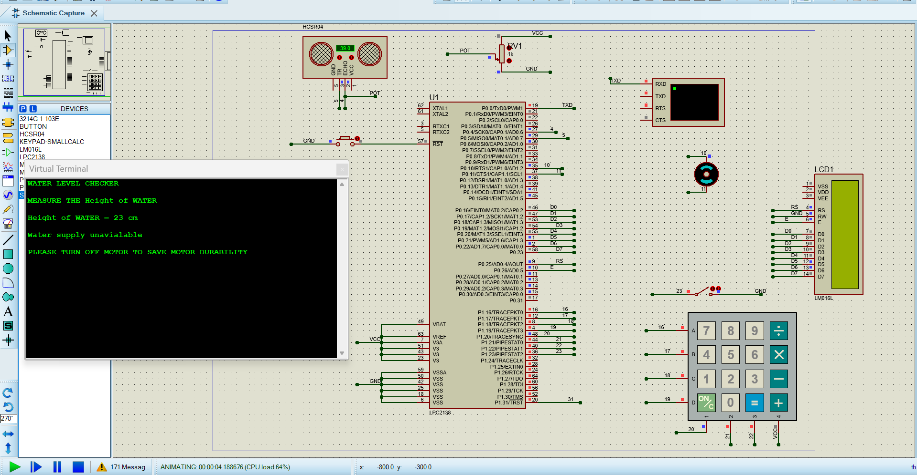

Slide 24
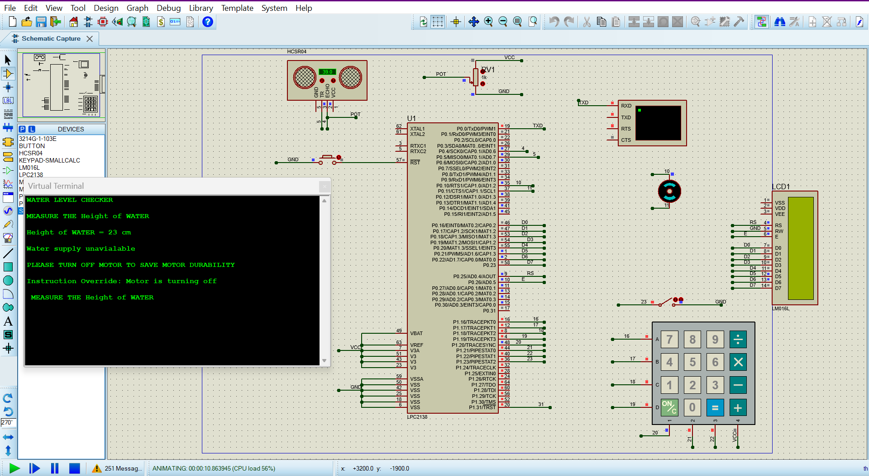

Slide 25
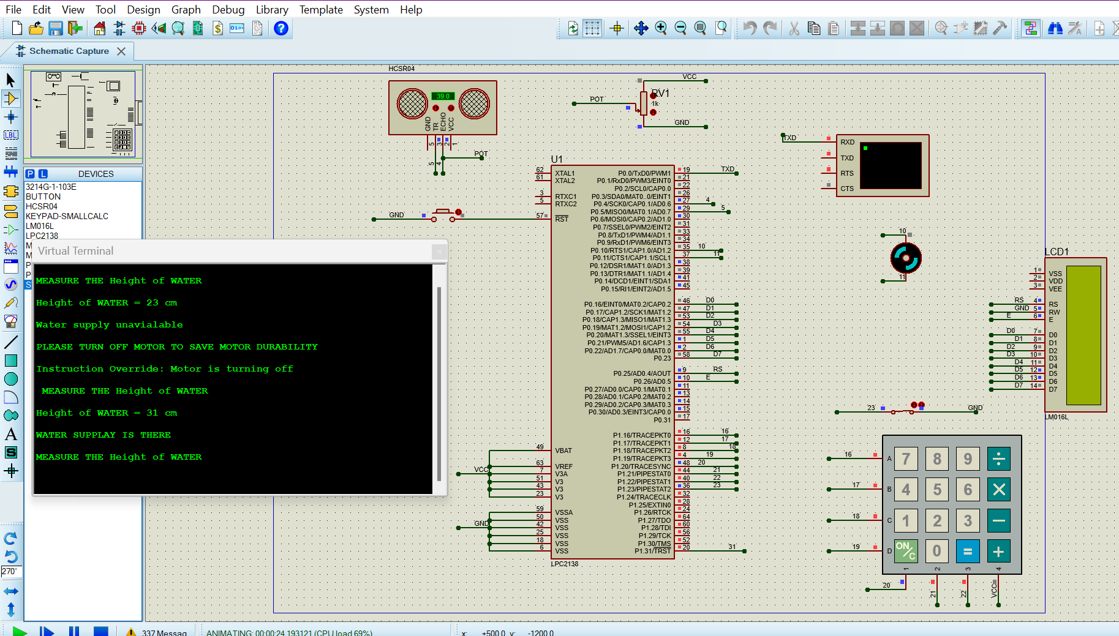

Slide 26
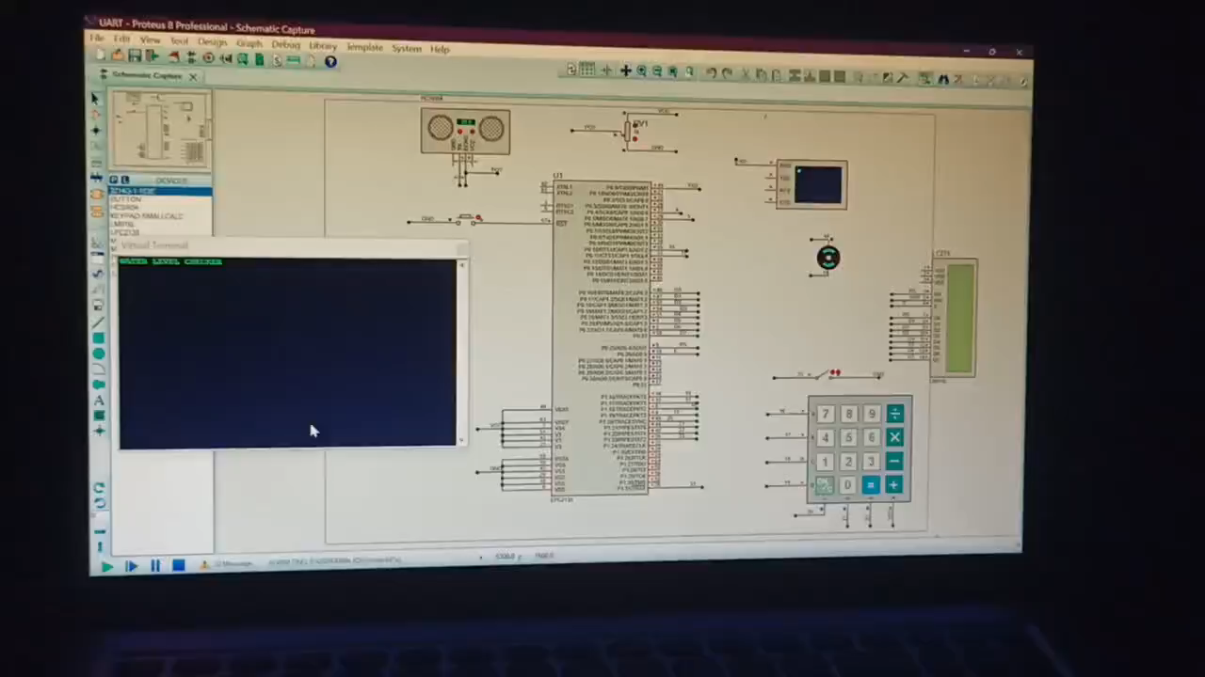

Slide 27
CONCLUSION
At the end of this course we are able to apply our ARM knowledge with real world application by interfacing the different peripherals and sensors.
We have learnt the following
1.Problem solving
2.Error debugging
3.Time management
4.Team work

Slide 28
THANK YOU

